Slide 1
mnist

Slide 2
introduction
CNN
Dataset
Colab

Slide 3

CNN

Slide 4



DAtaset
Mnist
Handing write numbers(0~9)

Slide 5
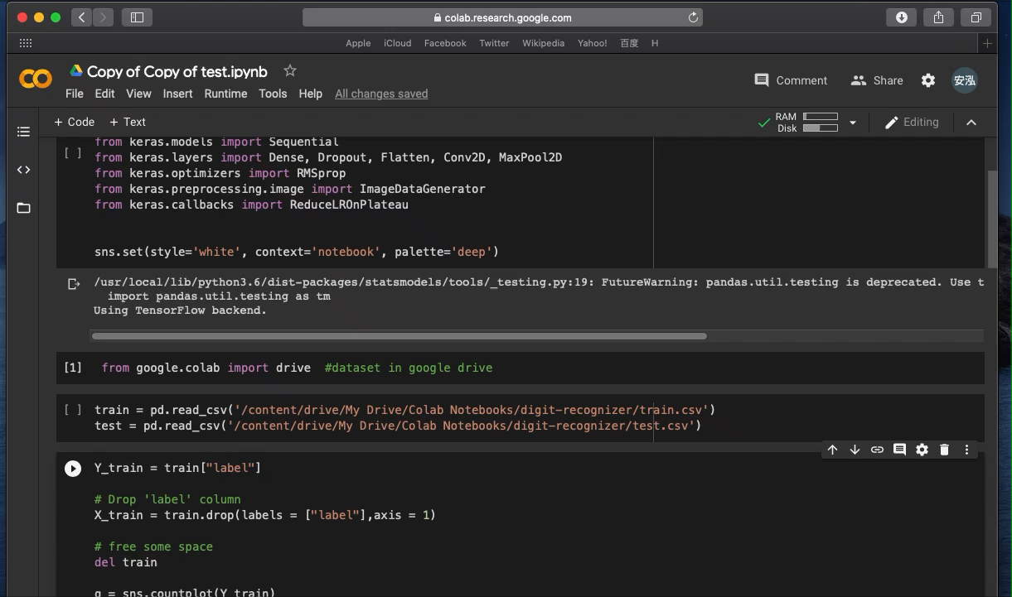
colab
Conect with google drive

Slide 6
reference
Code: https://www.kaggle.com/yassineghouzam/introduction-to-cnn-keras-0-997-top-6
Dataset: https://www.kaggle.com/c/digit-recognizer/data
Environment:google colab

